Slide 1

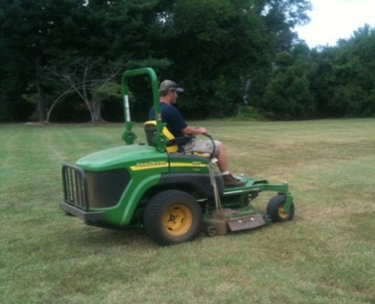
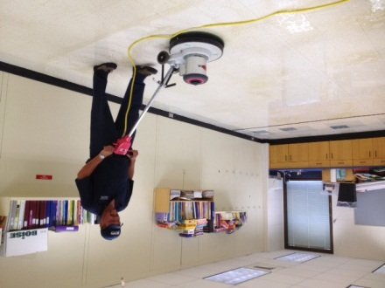
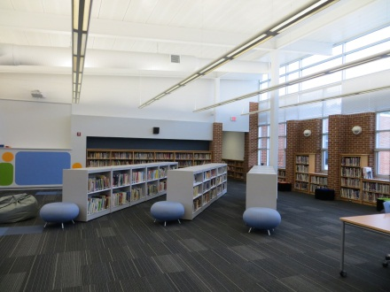
Building Services Department
Improvement Plan
Presented By: Joe Letteri, Director
01/09/2014

Slide 2
2013-14 Improvement Goals
Develop and implement an Indoor Air Quality Standard Operating Procedure.
Utilize APPA* Preventative Maintenance Performance indicators to:
    Extend the life of equipment and reduce unscheduled outages.
    Implement a plan to meet Comprehensive Stewardship Level II in grounds maintenance.
Provide alternative training materials to improve knowledge, skills, and communication within the custodial division.
Determine how many of the division’s current spaces are considered “contemporary learning spaces”, and then develop a plan to implement the change in the spaces that do not meet the criteria.
*The Association of Leadership in Educational Facilities

Slide 3
Why These Goals are Important
Anticipated outcomes include:
  Improved Indoor Air Quality for all occupants
  More efficient use of the County’s fiscal resources
  Improved customer satisfaction
  Improved workforce and quality of work
  More rigorous planning for contemporary learning spaces

Slide 4
Current Challenges
Maintenance staff limitations require us to choose between reactive work orders vs. preventative work orders.
New emphasis on pruning, as it relates to security, has increased the work load of the grounds crew
Creating a computerized training program utilizing video and log-in requirements is multifaceted and complex.

Slide 5
Current Successes
Employee training is underway:
  Mold Awareness Training completed for HVAC and Carpentry crews
  Custodial training is underway utilizing CompuClean & CompuCheck training materials
Criteria & metrics have been established:
  Equipment list and preventative maintenance schedules have been reviewed
  Grounds maintenance tasks are identified.
  Rubric for learning space evaluation has been prepared and is being vetted

